Slide 1

Analysis of COVID-19 Impact on Jobs in different sectors
Group 3: Team Members
Chaturvedi Devna
Muppalla Gireesh Kumar
Yarava Yugandhar
Gundumogula Mani Sai

Slide 2


Motivation
The COVID-19 situation has impacted the workforce causing many professionals to lose their jobs globally in many sectors namely, IT, Hardware, Banking, Finance, Telecom.
The concept of bigdata and its services have been implemented in various sectors to analyze this impact.
We streamlined the process of analyzing social media data using the existing techniques, visualize the data in a feasible way.
Reference: https://www.informationweek.com/big-data/big-data-analytics/analytics-pros-called-to-duty-in-covid-19-crisis/d/d-id/1337470?

Slide 3
Idea
Since the big data technologies deal with a large amount of data and makes it feasible to perform the analytics.
We choose to collect social media text data from Twitter analyze and aggregate the views, scenario of job market and perform sentiment analysis on COVID-19 data and make it presentable.

Slide 4
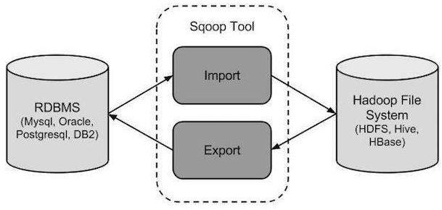
Features
Analysis of real-time twitter tweets from Twitter using SNScrape and twitter API.
Pre-processing the text data using NLP libraries.
Extracting data from Twitter and loading it to SQL
Performing ETL using Sqoop to import and export data between RDBMS and HDFS.
Querying using HQL

Slide 5

Objectives
To analyze the number of people worldwide who suffered from job losses, people searching for jobs in the current market situation about various sectors.
To analyze the data based on job sectors, job losses, gender, age group, etc.
We will be using a combination of tools using Hadoop Ecosystem, RDBMS, SNScrape, Twitter API, and python to collect the data, store, analyze and visualize the data.
Using Spark Sql/dataframe to perform queries on the data extracted from twitter

Slide 6
Significance
As the workforce is globally getting impacted by COVID-19, government should have the track of the people getting unemployed.
How is the economy of the country getting impacted?
How the situation should be tackled?
Big data supports the analysis of abundant amounts of data with great efficiency.
This analysis can help the workforce to make their decision in an informed manner.

Slide 7
Design and Workflow
Twitter
Spark SQL queries
Hive
Hadoop
MatplotLib
Seaborn
Extracting data from
Using Sqoop to
export data to
Sentiment
Analysis
Using Twitter API and SNScrape

Slide 8
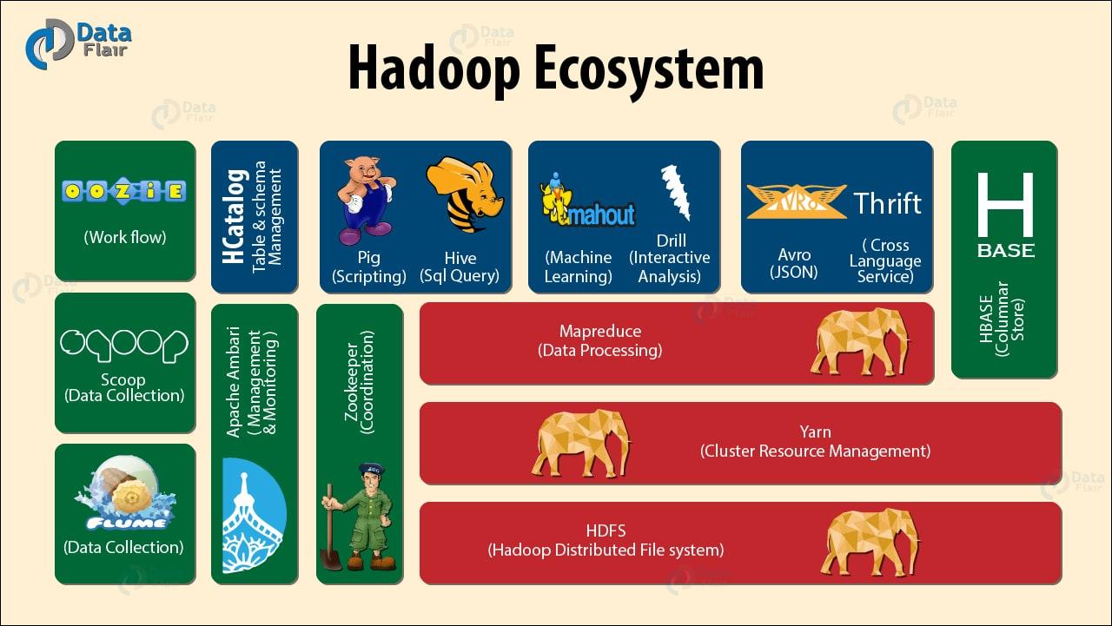
Architecture
Tools used
Hadoop – Storing the data
Hive – Filtering and Analyzing data
SQL (RDBMS) – Staging database to support realtime transactions
Sqoop – Import and Export Data
SNScrape – Extract data from Twitter
Twitter API – Extract real –time data from Twitter
Spark SQL queries
Matplotlib - Visualization
Seaborn - Visualization

Slide 9
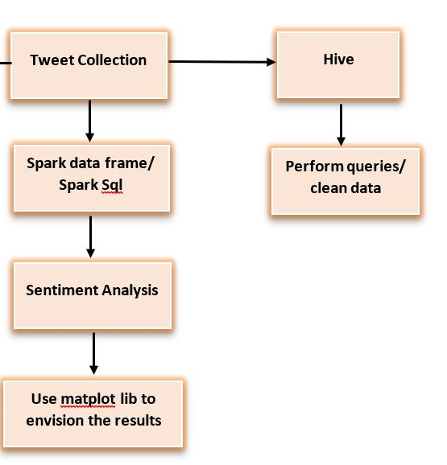
Project Model : Architecture Diagram

Slide 10
Dataset
The data we are collecting focuses on job losses and unemployment. The social media platform we have selected for data extraction is Twitter.
We are collecting Twitter data using Twitter batch API using Twitter developer account credentials. All tweets are in CSV format.
The collected data has an array of information about a tweet like Datetime, Tweet Id, Text, Username, Language, conversation Id, retweet Count, quoted Tweet, like Count, retweeted Tweet.
The hashtags used to scrape the data are Covid-19, CovidatWork, unemployment, coronavirus, pandemic, career, working poor, poverty.

Slide 11

Implementation

Slide 12
Implementation Details
Tweets Extraction
Pre-processing the text using python libraries
Loading the data in SQL
Storing in Hive HDFS
Using Sqoop for import and export between SQL and HIVE
Hive Operations: (initialization, table creation and loading data)
TextBlob for Sentiment Analysis
Visualization using MATPLOTLIB and Seaborn
Result Evaluation

Slide 13
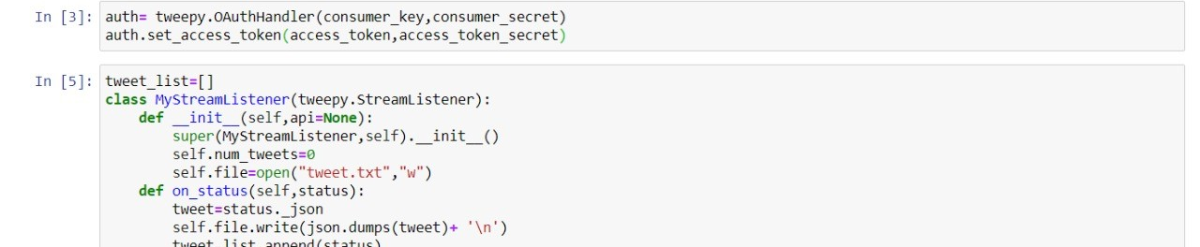
1. Extracting Text using SNScrape and Twitter API from Twitter
The first step includes extracting text data from Twitter using SNScrape and Twitter API: Hashtags used: Covid-19, CovidatWork, unemployment, coronavirus, pandemic, career, working poor, poverty.
a) Importing tweepy and json to extract text data from twitter

Slide 14
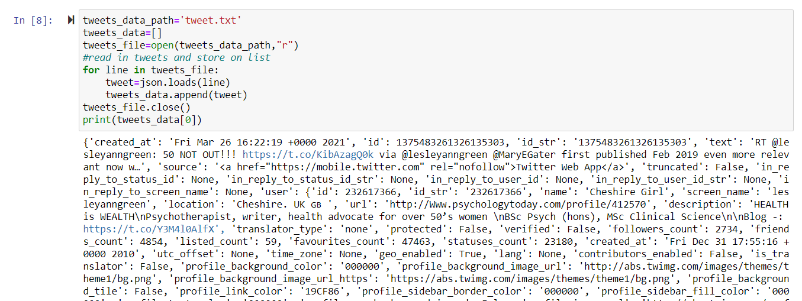
2. Using tweepy provide the hashtags for which the data is to be extracted.
3. Give the path for the text file to save the extracted tweets

Slide 15
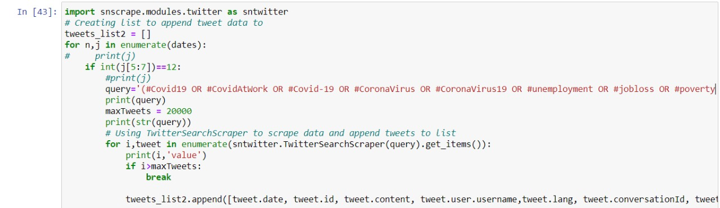
4. Scrape the data from twitter using snscrape
Result: 700,000 tweets are collected from twitter encompassing tweets on unemployment and covid-19 scenario.
After extracting the tweets two different sets of analysis are performed
Part a) Spark data frame/ Spark Sql
Part b) Loading the data to Hive

Slide 16
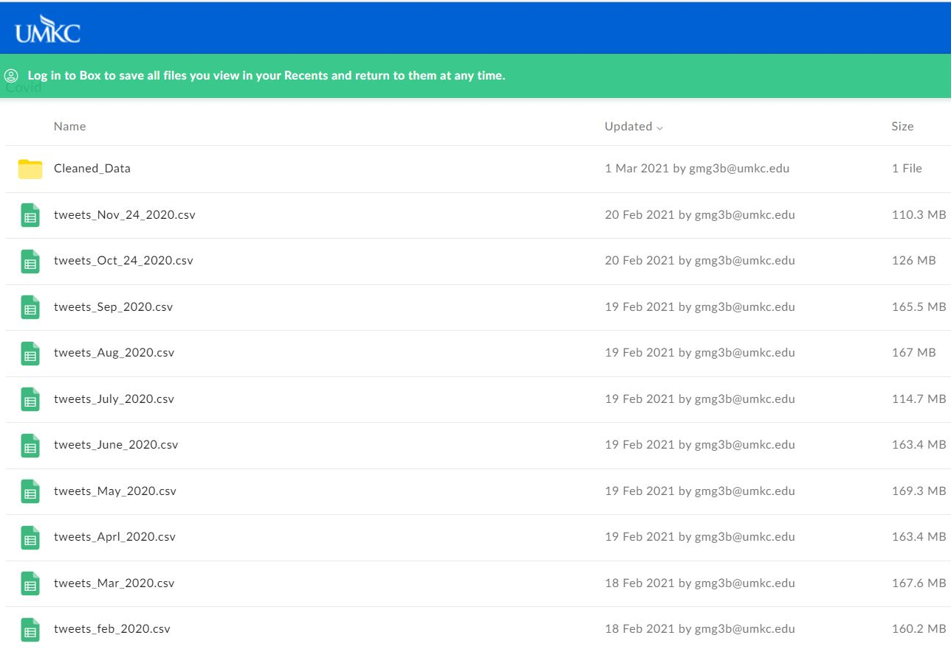
Monthly Tweets data on COVID-19

Slide 17
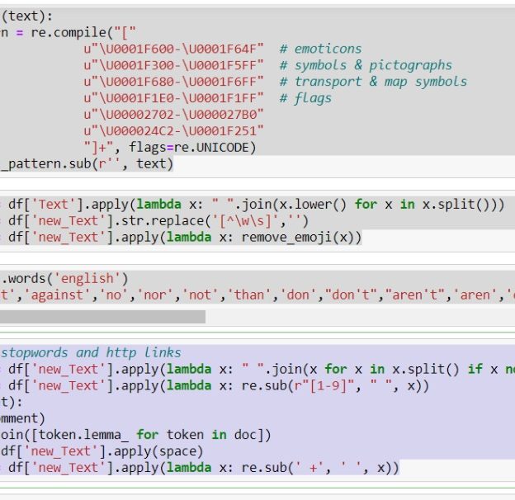
Pre-processing of Text Data in Python
The pre-processing of text data includes cleaning of data:
Stop words
Special characters and punctuation
Emoji’s
HTTP Links
Numbers
Lemmatization

Slide 18
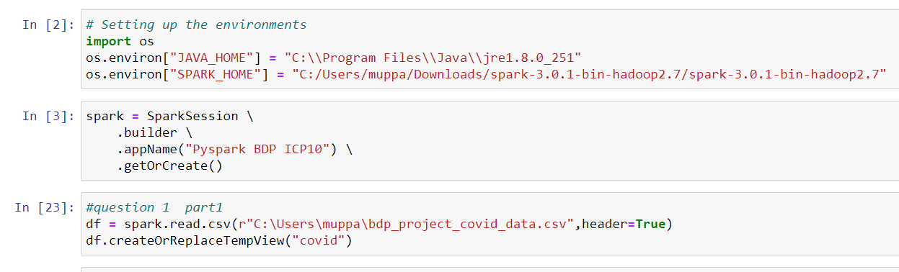
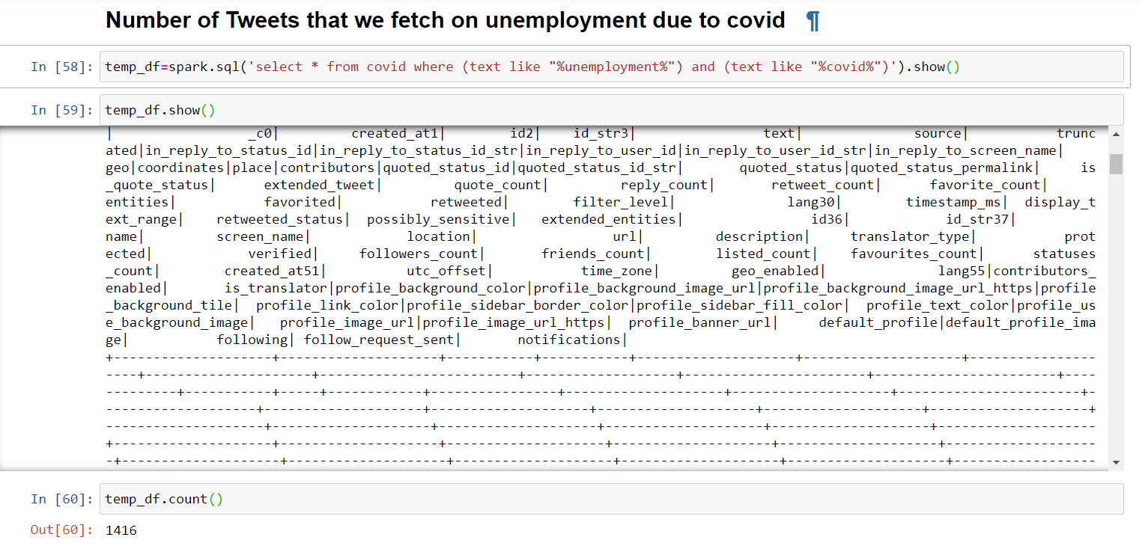
Part A) Spark data frame/ Spark Sql
Step 1) SPARK/SQL queries
a) The number of tweets fetched on unemployment due to COVID-19 using sparl.sql query to create a dataframe.
The tweets are imported in a csv file and using Spark Sql queries analysis is performed

Slide 19
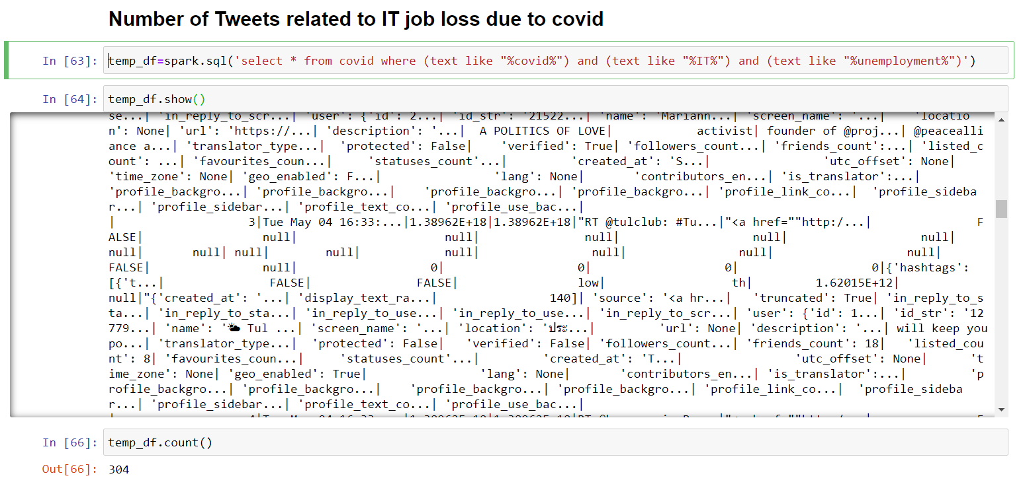
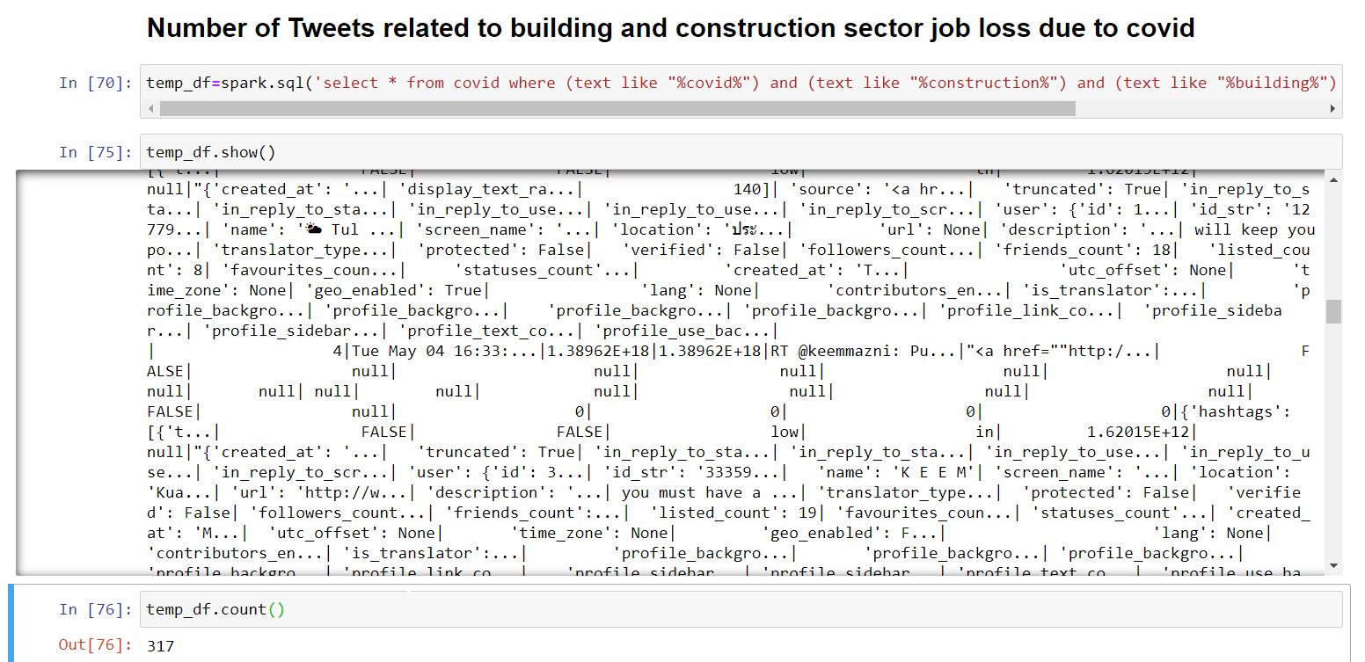
b) Spark Sql query to determine the loss of jobs in IT sector using tweets data
c) Spark Sql query to determine the impact of unemployment in construction sector using tweets data

Slide 20
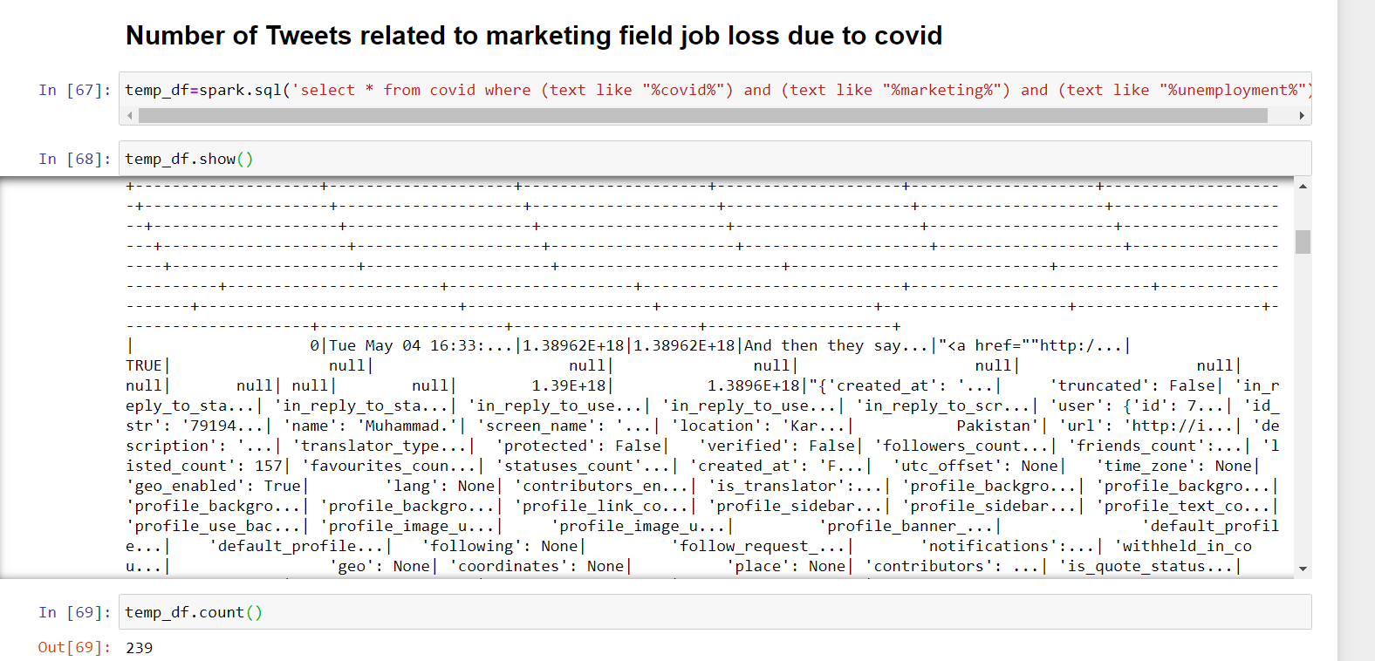
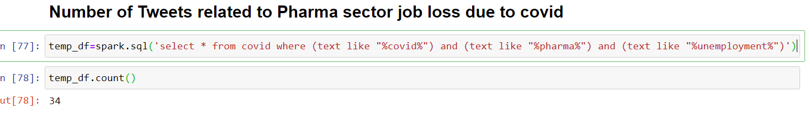
e) Spark Sql query to determine the impact of unemployment in Pharmaceutical sector using tweets data
d) Spark Sql query to determine the impact of unemployment in marketing sector using tweets data

Slide 21
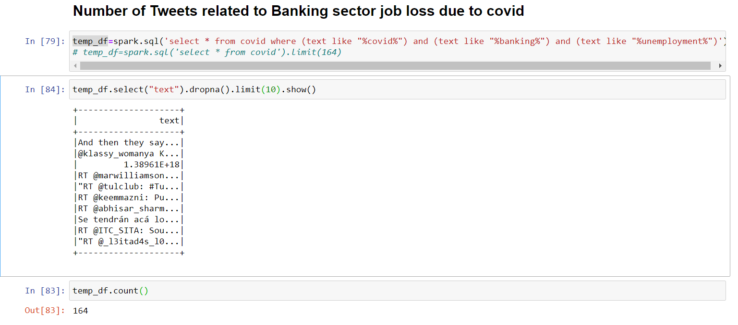
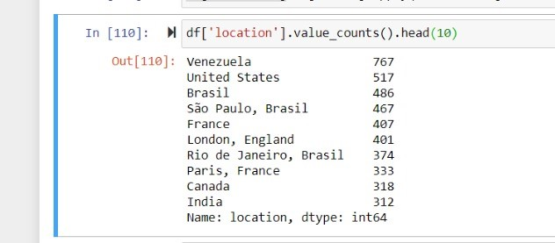
g) Query to determine the location of top 10 tweets
f) Spark Sql query to determine the impact of unemployment in Banking sector using tweets data

Slide 22
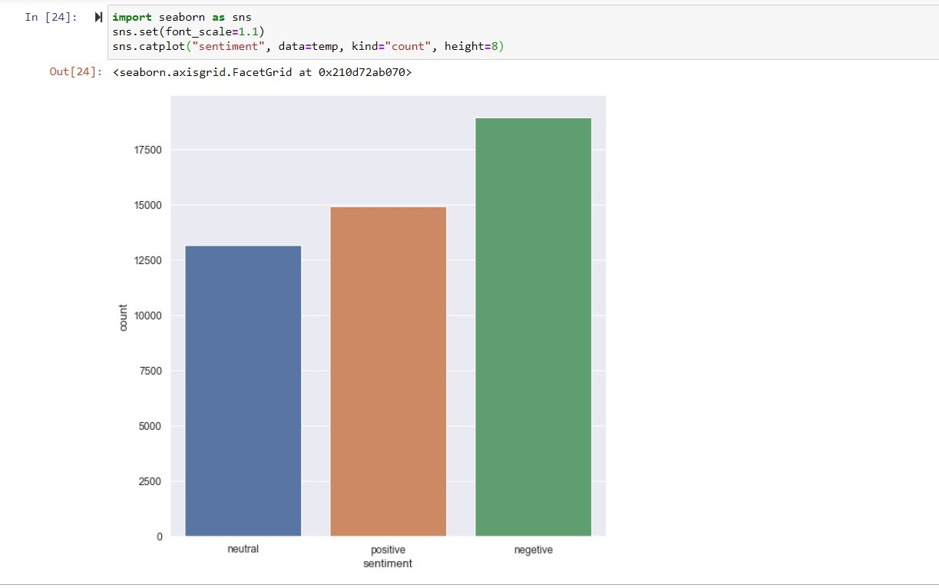
Step 2) Perform Sentiment Analysis
Sentiment Analysis Graph

Slide 23
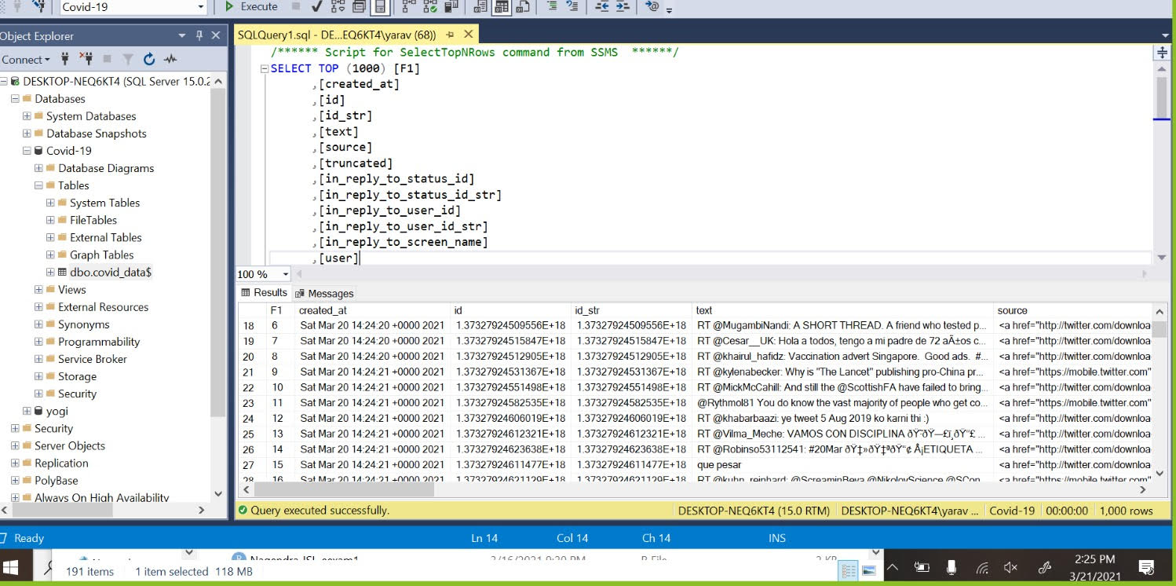
Part B) Loading the data to Hive
Step 1: Imported the data to SQL server
The data extracted from twitter is loaded into SQL server directly. The SQL database acts as a staging database between Twitter API and Hadoop hive. After completing the incremental loads to transfer the data to Hive using sqoop , the data s truncated from SQL database.

Slide 24
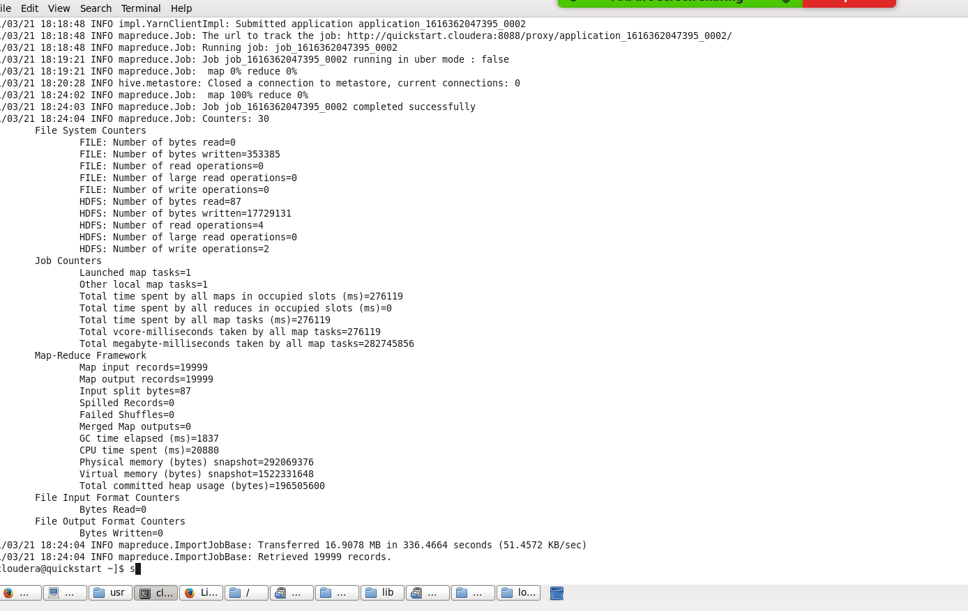
Step 2– Export the data from SQL to HADOOP - HIVE using Sqoop

Slide 25
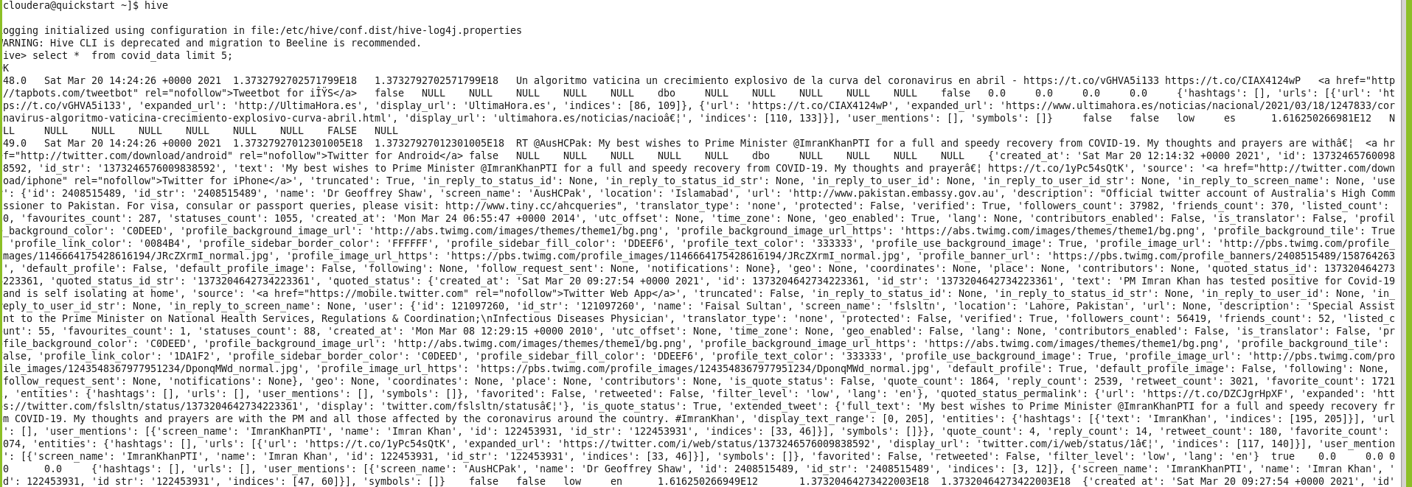
Check the COVID data loaded in HIVE using HQL

Slide 26

Results and Evaluation

Slide 27
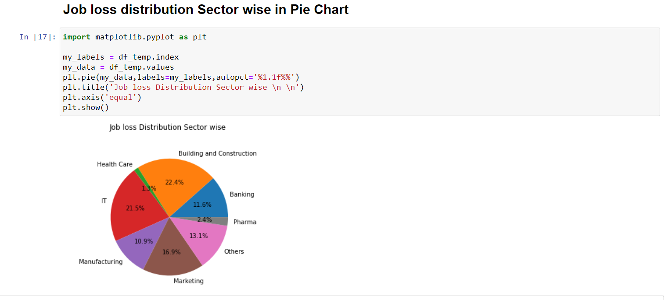
Results and Evaluation:Diagrams and Charts depicting the results of Data analysis and exploration
Result 1: We have used matplot lib to display the results obtained by performing Data analysis
The pie chart below show the job losses distribution sector wise

Slide 28
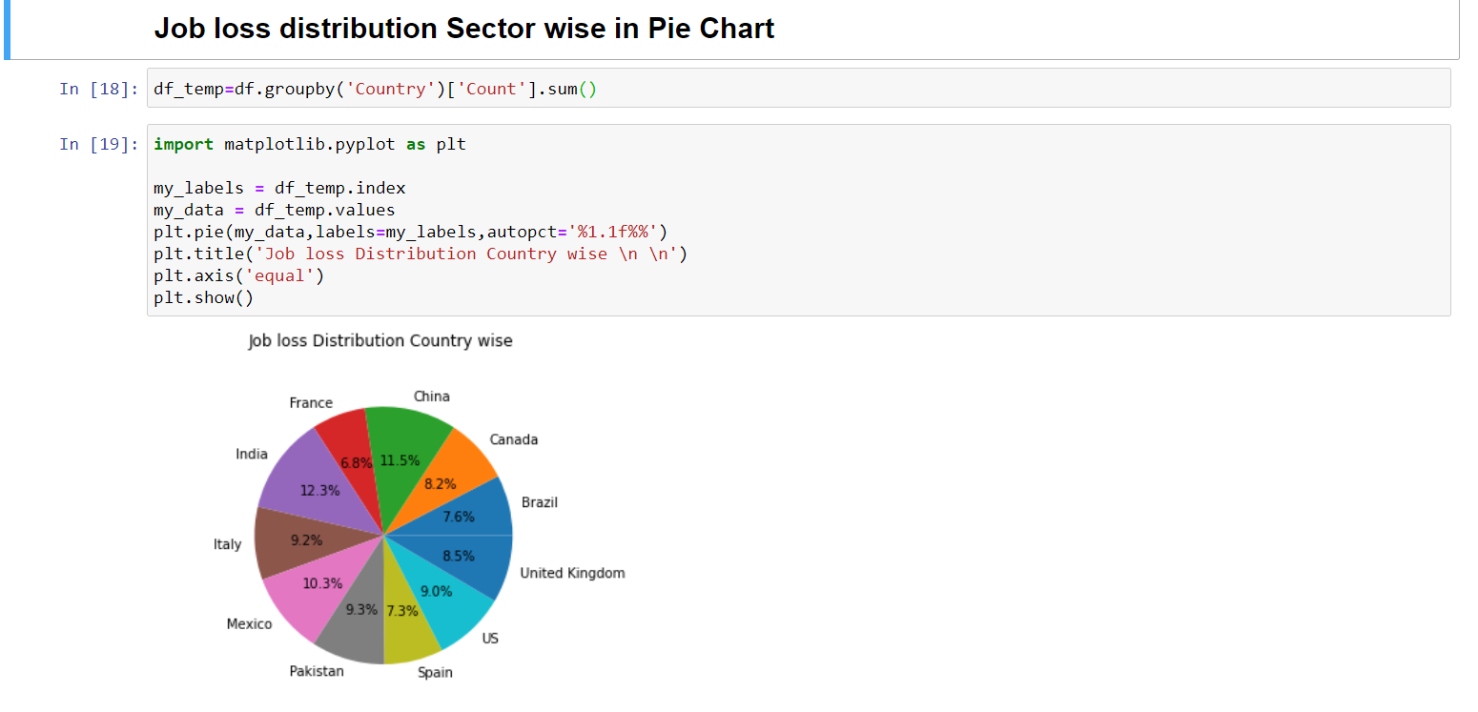
Results and Evaluation:Diagrams and Charts depicting the results of Data analysis and exploration
Result 2: The pie chart displays the percentage of Job loss distribution in various countries

Slide 29
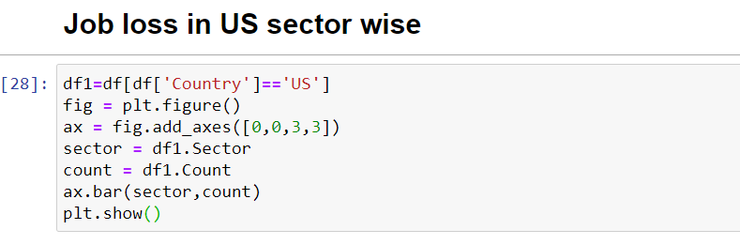
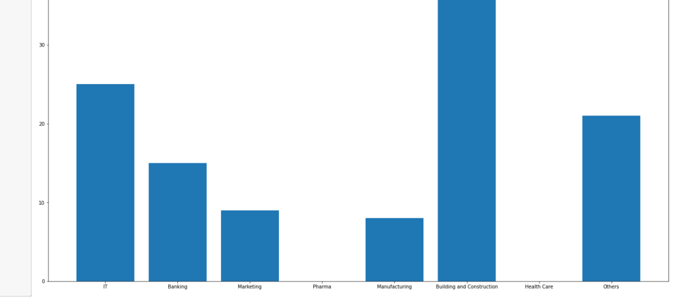
Results and Evaluation:Diagrams and Charts depicting the results of Data analysis and exploration
Result 3: The bar graph below shows the distribution of job losses in US sector wise

Slide 30
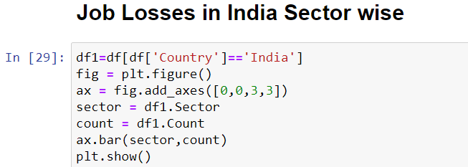
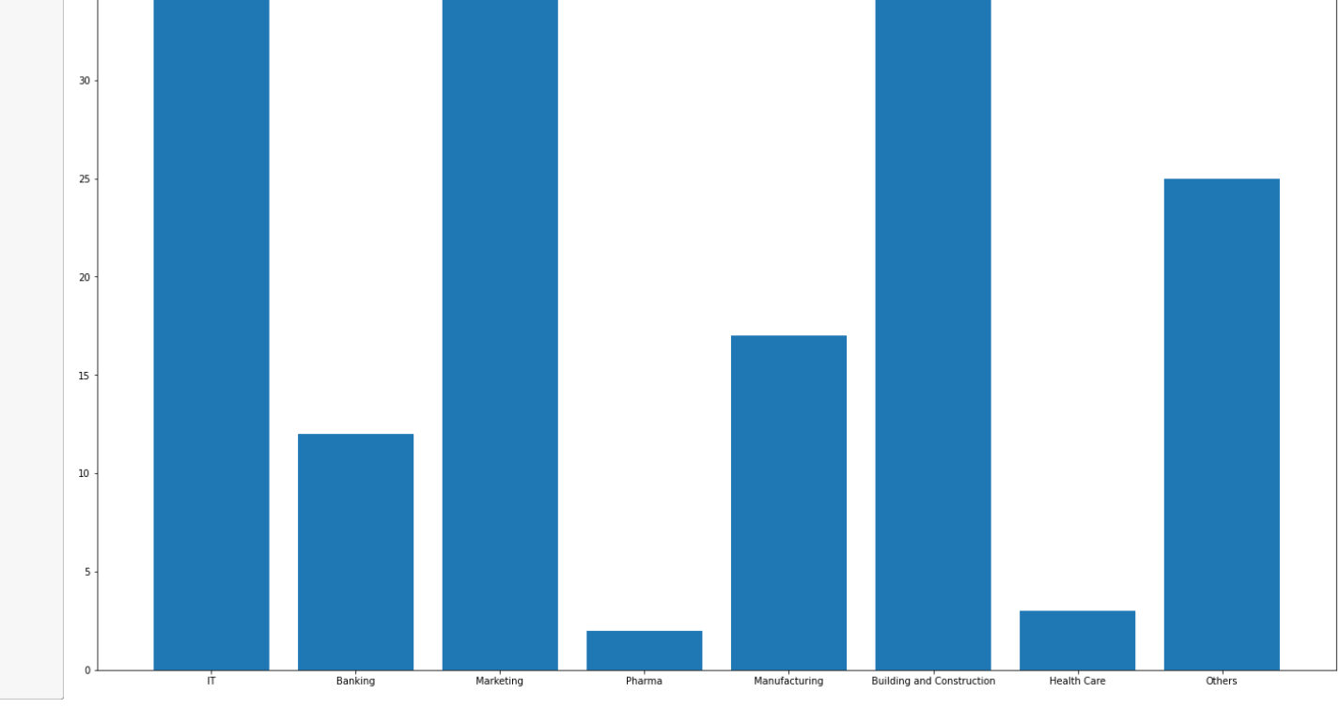
Results and Evaluation:Diagrams and Charts depicting the results of Data analysis and exploration
Result 4: The bar graph below shows the distribution of job losses in India sector wise

Slide 31
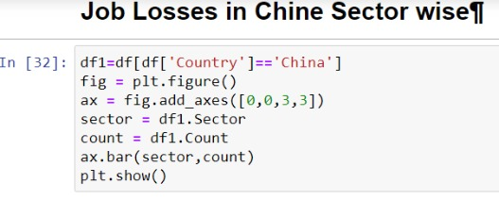
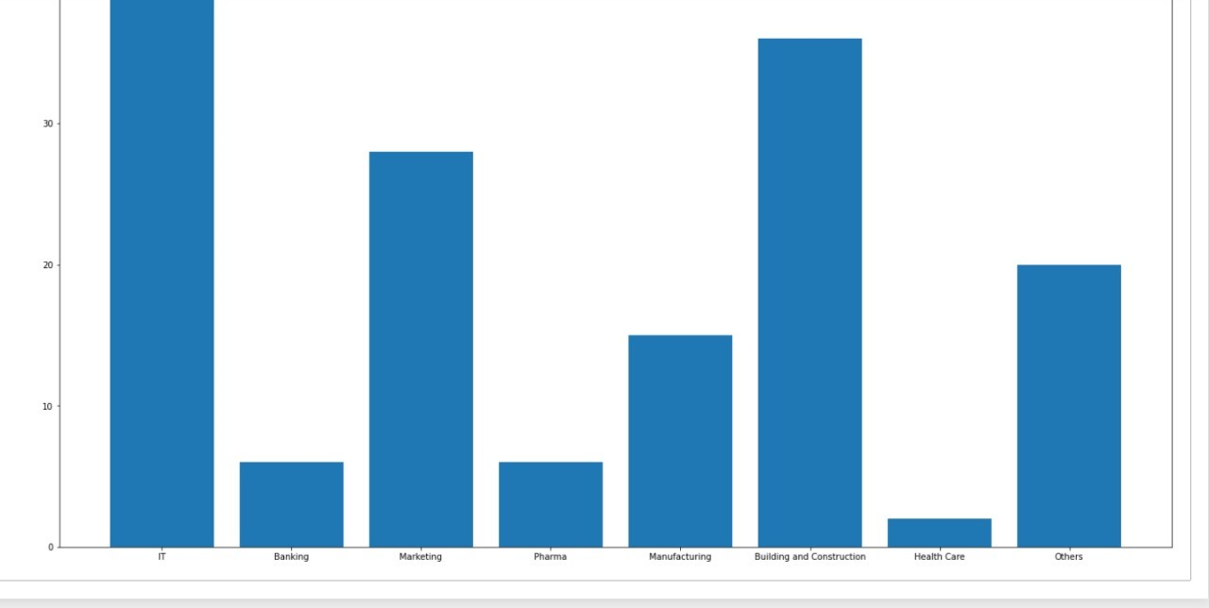
Results and Evaluation:Diagrams and Charts depicting the results of Data analysis and exploration
Result 5: The bar graph below shows the distribution of job losses in China sector wise

Slide 32
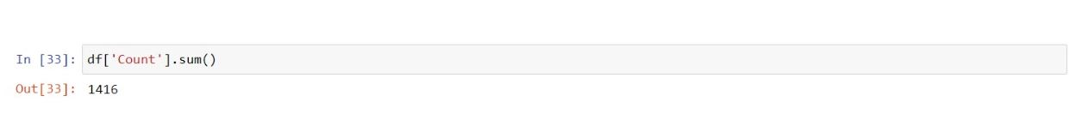
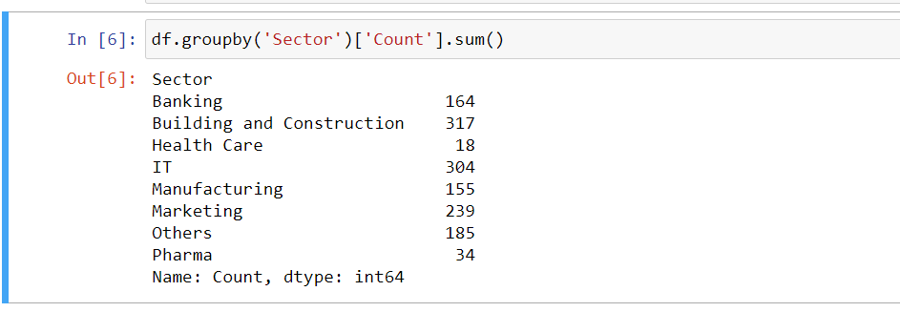
Results and Evaluation:Diagrams and Charts depicting the results of Data analysis and exploration
Result 6: Total number of tweets corresponding to unemployment due to COVID-19
Result 7: The count of the tweets is performed using Spark actions and transformations. The query provides the number of job losses in each of the provided sectors as enlisted below.

Slide 33




Project Management
Gireesh Kumar Muppalla – 25%
Mani Sai Gundumogula – 25%
Devna Chaturvedi – 25%
Yugandhar Yarava – 25%
Extracting Text using SNScrape and Twitter API from Twitter – Mani Sai Gundumogula
Pre-processing of Text Data in Python – Gireesh Kumar
Imported the data to SQL server – Yugandhar Yarava
Export the data from SQL to HADOOP - HIVE using Sqoop – Devna Chaturvedi
Phase 1
Phase 3
Design of the project – Yugandhar Yarava
Investigating the datasets – Mani Sai Gundumogula
Designing the flow of the project – Devna Chaturvedi
Decide the tools to be used for implementation - Gireesh Kumar Muppalla
Phase 2
Contributions
Loading Data into Spark and use pyspark for data analysis and Documentation – Devna Chaturvedi
Spark queries for data analysis and statistics using SPARK SQL – Gireesh Kumar Muppalla and Mani Sai Gundumogula
Sentiment Analysis using Matplotlib and Seaborn - Yugandhar Yarava

Slide 34

Github Repository
Github Repository Link: https://github.com/ManiSaiGundumogula/UMKC-BDP-Final-Project
Github Wiki Page Link: https://github.com/ManiSaiGundumogula/UMKC-BDP-Final-Project/wiki/Final-Project-Report

